Slide 1
Lightweight OS for Embedded Systems
By: M00874904

Slide 2
Objective:
The main objective of my project was to create, a simple file system, for small embedded systems. The file system is able to:
Create a Directory
Remove a Directory
Create a File
Remove a File
Read from File
Write to File
Navigate directories and files

Slide 3
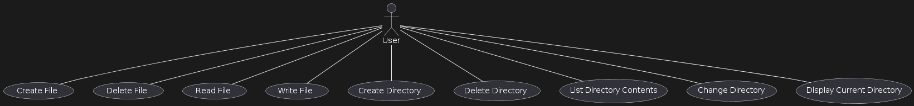
Use Case Diagram:
Each of the operations are interacted with user.
Made with: Plant UML

Slide 4
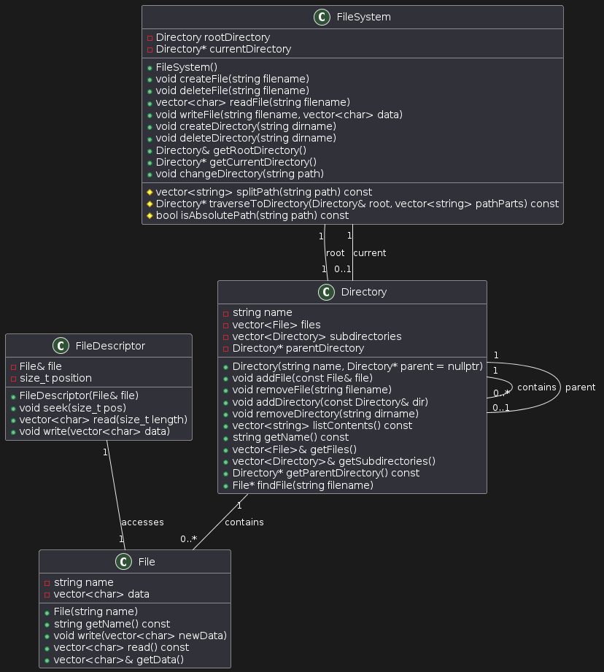
UML Diagram
Made with: Plant UML
This UML diagram depicts the design of my application.
It comprises of 4 main classes:
File
File Descriptor
Directory
File System
Apart from these classes, there is a main file, and a test file. Main includes a menu driven design to interact with the file system, whereas test file uses catch2 module, to check and assert the various scenarios that might be encountered in my system.

Slide 5
File:
It is a basic representation of a file in an operating system.
The name of the file is stored as string, where as its data is stored in a vector of characters.
It has various methods to access and interact with files.
File Descriptor:
It contains the basic information regarding the file, but not the actual file data.
It saves the files location.
It also keeps track of file Size

Slide 6
3. Directory:
It is the representation of a directory.
Name is stored in the string, and it has vector of file objects to store files.
It also contains a vector of directories to contain sub-directories.
It also include various methods to interact with directory, and change its state
4. File System:
It is the backbone of the whole application.
It consists of all the logic, of interaction of various classes with each other.
It also has mechanism for navigating back and forth in directories
Controls pointers to various paths in my application

Slide 7
Testing
I tested my system rigorously with various test cases, depicting different scenarios. Testing was done using catch2, a famous frame work for unit tests in cpp.

Slide 8
Conclusions
All in all, this project is complete, as all the requirements asked in the pdf are fulfilled. A better approach in future would involve, using a more modularized and object oriented approach, to tackle the problem. Even though my code is still Object oriented, I feel like it can be more modularized.
THANKS

